Slide 1

Design-Think Your Life Session 2

Slide 2


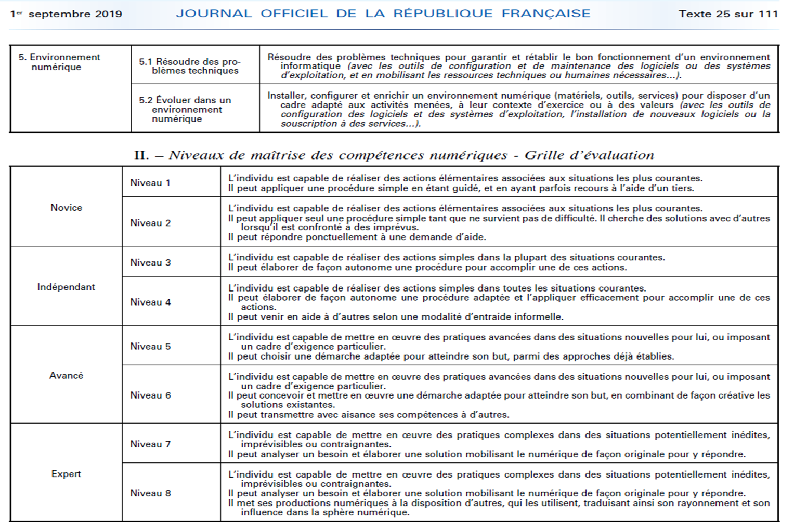
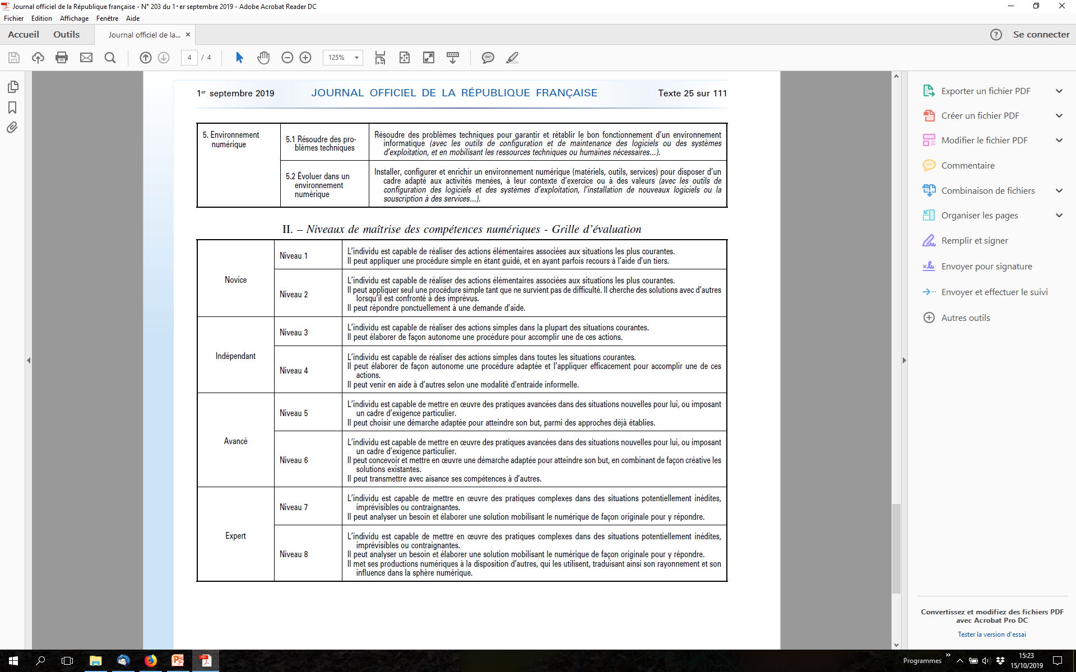
Le décret 2019-919 crée un cadre de référence
des compétences numériques (CRCN)

Slide 3



Anti cyber-bullying campaigns

Slide 4
Anti cyber-bullying campaigns

Slide 5



Anti cyber-bullying campaigns

Slide 6
Initiative, Attitude, Proactivity
You have developed your soft skills for this class (session 5):
Autonomy & creativity: Read the ePortfolio resources on Moodle SHS & create a basic Wix (?) ePortfolio
Curiosity: Try out a « career development » personality test https://www.truity.com/view/tests/personality-career
https://www.etsglobal.org/Tests-Preparation/Workforce-Assessment-Solutions/WorkFORCE-Assessment-for-Job-Fit
Networking, e-reputation, personal branding: Join LinkedIn & T H I N K
Design Thinking your Life:
Complete the Journaling, Workview & Lifeview activities (pp.1-3)
Watch the TED Talks https://www.youtube.com/watch?v=SemHh0n19LA https://www.youtube.com/watch?v=fkvIwq7oxzM

Slide 7


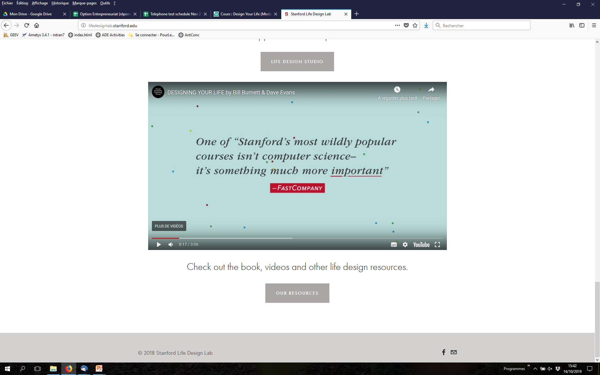

Slide 8

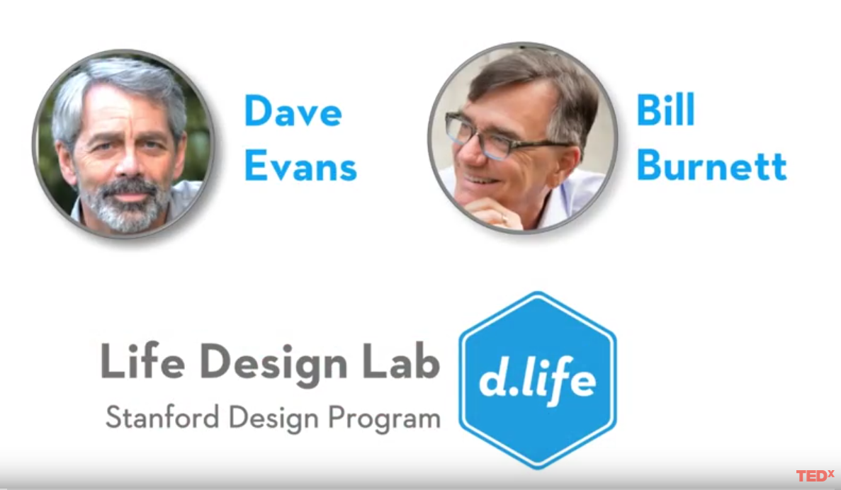

Slide 9

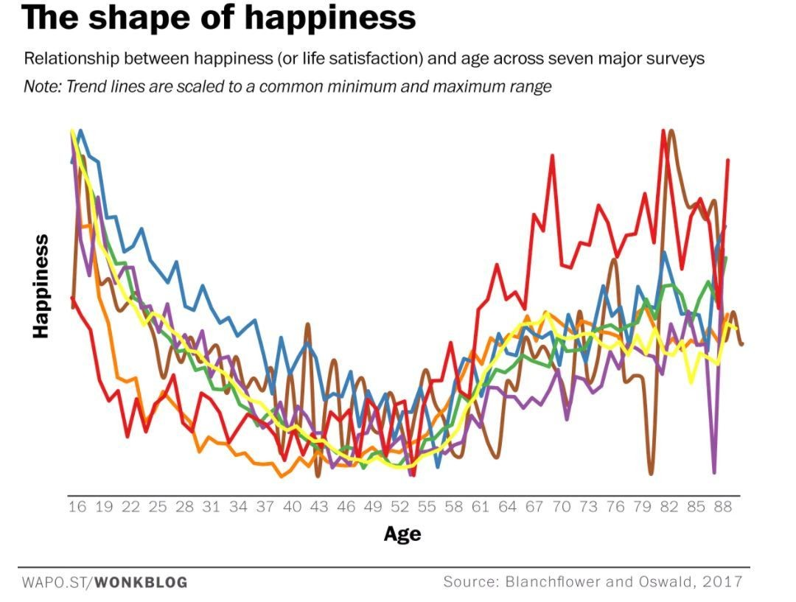

Take the time to
develop self-knowledge
design-think your life
build your life « fit »

Slide 10
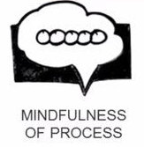
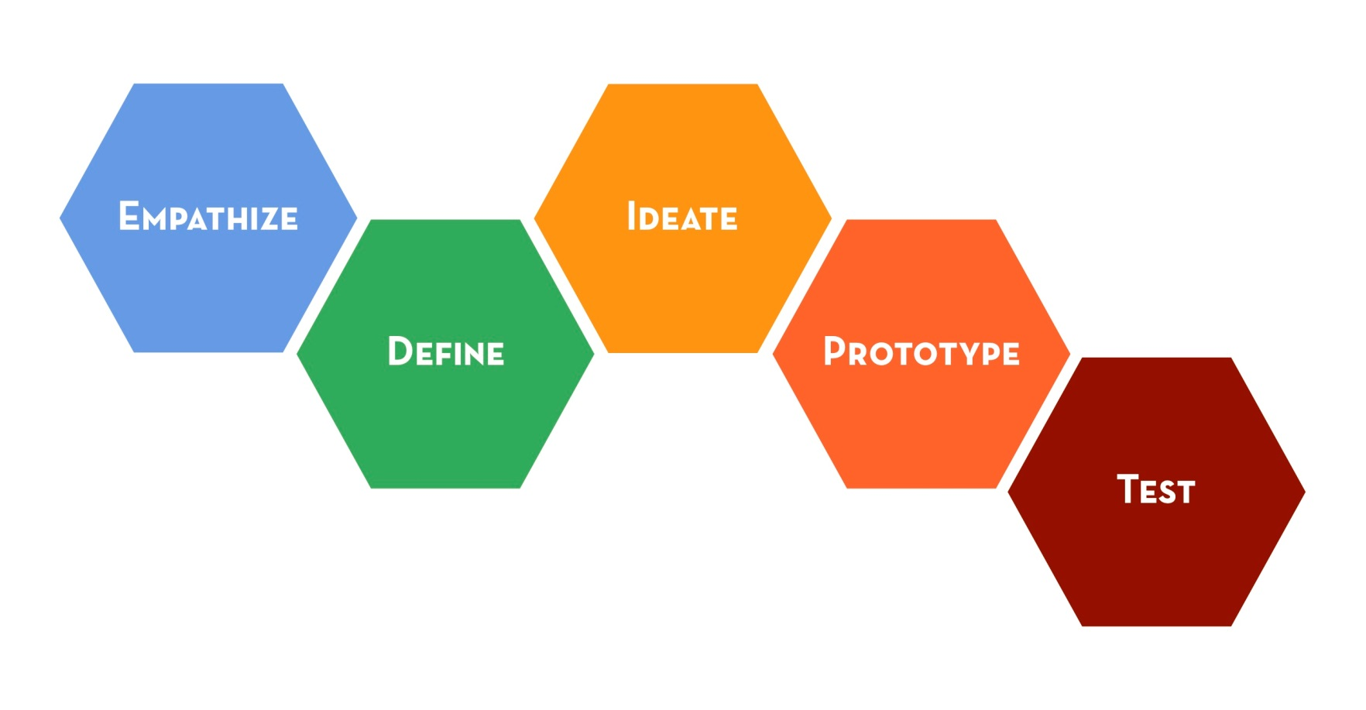
Design Thinking
…with you!
Connect
the dots –
do a
work & life
overview
…3 five
year
odyssey
plans
…gravity
problems
…your
life
…by assessing your choices
Source: https://www.google.com/search?q=design+thinking&client=firefox-b&source=lnms&tbm=isch&sa=X&ved=0ahUKEwidvfTy7ujiAhVyA2MBHYABAsEQ_AUIECgB&biw=1920&bih=1035#imgrc=vuNSwWfNpuAsDM:

Slide 11



Journaling : Work, Love, Play, Health
Building a compass : Workview & Lifeview

Slide 12
Journaling : Work, Love, Play, Health
Think, share in pairs
2. Building a compass : Workview & Lifeview
Think, share in pairs

Slide 13
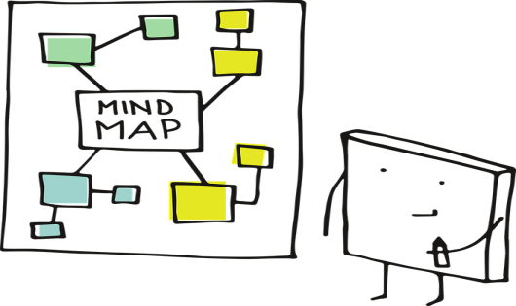
Journaling : Work, Love, Play, Health
Think, share in pairs
2. Building a compass : Workview & Lifeview
Think, share in pairs
3. Mindmapping your Engagement, Energy, Flow
Think

Slide 14
4. Ideating :
a. Look at the outer ring of your mind map
& pick 3 unconnected items
b. Combine them into a job description (forget practicalities) & draw a quick visual sketch

Slide 15
4. Ideating :
a. Look at the outer ring of your mind map
& pick 3 unconnected items
b. Combine them into a job description (forget practicalities) & draw a quick visual sketch
c. Do it again for 3 different possible jobs

Slide 16

5. Prototyping : your odyssey plans
Create 3 alternative 5 year plans : follow steps a) to e) on page 6
Think, then share in pairs

Slide 17
5. Prototyping : your odyssey plans
Create 3 alternative 5 year plans : follow steps a) to e) on page 6
Think, then share in pairs
Review your 3 odyssey plans : list & plan as on page 7
Think, then share in pairs

Slide 18

6. Reframing failure & developing growth mindset

Slide 19


6. Reframing failure & developing growth mindset

Slide 20
6. Reframing failure & developing growth mindset
Look back over the recent past & log your failures

Slide 21
6. Reframing failure & developing growth mindset
Look back over the recent past & log your failures
Categorize errors, weaknesses, growth opportunities

Slide 22
6. Reframing failure & developing growth mindset
Look back over the recent past & log your failures
Categorize errors, weaknesses, growth opportunities
Identify your growth insights, then share in pairs

Slide 23
6. Reframing failure & developing growth mindset
Look back over the recent past & log your failures
Categorize errors, weaknesses, growth opportunities
Identify your growth insights
Convert failures to growth regularly

Slide 24
6. Reframing failure & developing growth mindset
Look back over the recent past & log your failures
Categorize errors, weaknesses, growth opportunities
Identify your growth insights
Convert failures to growth regularly
Continue the process to build a growth habit & mindset

Slide 25
Initiative, Attitude, Proactivity
Develop your phone task soft skills for session 6 :
Autonomy & creativity: Read the ePortfolio resources on Moodle SHS & create a basic Wix (?) ePortfolio
Curiosity: Try out a « career development » personality test https://www.truity.com/view/tests/personality-career
https://www.etsglobal.org/Tests-Preparation/Workforce-Assessment-Solutions/WorkFORCE-Assessment-for-Job-Fit
Networking: Join LinkedIn & develop your personal brand/e-reputation
Design thinking your life: Complete the worksheet activities & watch the TED Talks https://www.youtube.com/watch?v=SemHh0n19LA https://www.youtube.com/watch?v=fkvIwq7oxzM
Self-awareness, self-knowledge, self-management: Read the 4 docs on Moodle SHS LM L3 Module 1 & prepare for your telephone task

Slide 26

Telephone task (session 6)
Check 4 docs on Moodle SHS LM Module 1 Design Your Life

Slide 27
Telephone task (session 6)
Check 4 docs on Moodle SHS LM Module 1 Design Your Life
1) Schedule : Your timeslot is either during your LM or PE class in week 45 (November 4th-8th)
Sport & LV2 classes are scheduled as usual in week 45

Slide 28
Telephone task (session 6)
Check 4 docs on Moodle SHS LM Module 1 Design Your Life
1) Schedule : Your timeslot is either during your LM or PE class in week 45 (November 4th-8th)
Sport & LV2 classes are scheduled as usual in week 45
2) Instructions : Read carefully before the task
The telephone task is in English
Each student telephones their interviewer with their own phones

Slide 29
Telephone task (session 6)
Check 4 docs on Moodle SHS LM Module 1 Design Your Life
1) Schedule : Your timeslot is either during your LM or PE class in week 45 (November 4th-8th)
Sport & LV2 classes are scheduled as usual in week 45
2) Instructions : Read carefully before the task
The telephone task is in English
Each student telephones their interviewer with their own phones
3) Questions :
Reflect, use suggested tools & prepare your answers before the task
Do not read from notes

Slide 30

Telephone task (session 6)
Check 4 docs on Moodle SHS LM Module 1 Design Your Life
1) Schedule : Your timeslot is either during your LM or PE class in week 45 (November 4th-8th)
Sport & LV2 classes are scheduled as usual in week 45
2) Instructions : Read carefully before the task
The telephone task is in English
Each student telephones their interviewer with their own phones
3) Questions :
Reflect, use suggested tools & prepare your answers before the task
Do not read from notes
4) Rubric : Evaluation focuses on soft skills:
Self-knowledge, self-awareness, self-management

